Slide 1
THE CONCEPT OF THE BUSINESS IS THE PURPOSE

Slide 2
AGENDA
The concept and slogan
The problem/Opportunity
The solution
The implementation
The market
The customer
The competition
Our strategy
The team
Market challenges
Market plan
Business model

Slide 3
THE CONCEPT
A social company of a new fashion line to fight child labour and support education.
A new purpose to buy
A new conscious way to buy
“Better world, through better fashion”
Be part of the solution

Slide 4
Our slogan
With every item you buy, you are contributing to the education of a child in need: EUR 5 = books and stationary for 1 child for 1 year.
By buying this item, you are supporting education of a child in need: EUR 3 = a pair of shoes for 1 child

Slide 5
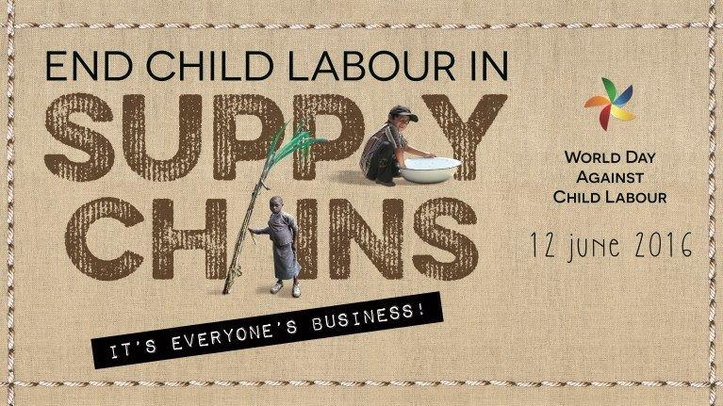
The problem – Child Labour
ILO- Global number of children in child labour 168 million children
Italy, Spain, Greece, Portugal, Serbia, Croatia, Bosnia and Herzegovina, Albania, Macedonia, Slovenia, Montenegro, Malta, Andorra, Gibraltar, San Marino, Holy See

Slide 6
The problem – Fast Fashion
The second polluter in the world, after oil. Some facts:
- 2.700 litres of water to make a T-shirt
- 11.000 litres of water to make a pair of jeans
- More than 150 billion garments are produced annually, enough to provide 20 new garments to every person on the planet, every year.
- Cotton is the world’s single largest pesticide-consuming crop, using 24% of all insecticides and 11% of all pesticides globally, adversely affecting soil and water.

Slide 7
By donating a % of profits to NGOs working on child elimination program and supporting education
The Opportunity
We want to give a difference experience of buying.
By knowing the impact the donations have and with sustainable clothing

Slide 8
The solution
- The need to have a better world and contribute to sustainability
- The need to make people more conscious about their consumption habits, as they are victims, and make them aware of the impact that their consumptions have on the world and the adverse effects to their health and well-being.
- The need to increase awareness about sustainability
- The need to increase awareness about social impact with a simple and tangible idea
- The need to promote social and environmental performance, transparency and accountability, buy doing business as a force for good.

Slide 9
The implementation
1st State:
A online platform to sell the company’s own line of sustainable fashion products
Sell sustainable independent fashion designers clothing

Slide 10
The implementation
2nd stage: An online platform to provide one “stop” shop solution to customers based on circular fashion industry:

Slide 11
The Implementation
- To buy white brand sustainable basic products (T-shirts, polos, shirts, caps...) based on best certificates like GOTS, FairTrade, organic...
- To print designs and embroider logo
- To label them with information about cost, impact of the donation, designer, printer, who made the clothes,
- To sell online
- To partner with NGOs in India, the second country in the world of garment industry production
- To promote the online platform to increase awareness

Slide 12
The market and the customer
European countries
Middle-to-high income
1st Segment: 16-30 years old who are normally more conscious about environmental and social issues
2nd Segment: older than 30 years old with a different line of products.

Slide 13
The competition
Online retail platforms with designed Tshirts, polos,....
Online retail platforms selling sustainable fashion

Slide 14
The strategy – B corporation
Fight against child labour
SDG4
Transparency
Conscious consumption
Better world, better fashion
Impact
SDG12
Support children education
Circular Economy
Organic, recycled, Fair Trade

Slide 15
Market challenges
Timing: Very crowded market.
Response: To differentiate with the mix of activities (Social, sustainable, fight child labour, ..)
Requirements: To reach big audience fast
Response: Try to get press coverage to increase awareness of the brand

Slide 16
Market plan
Company Set-up during first week of July
Product test 4Q 2016
Commercial release 1Q 2017
Aggressive social media promotion
Active in social entrepreneurs forums
Storytelling videos, stories
Participating in key groups (European Clothing Action Plan, ILO Child Labour Plan

Slide 17
Annexes

Slide 18
- Business model – Link with UN SDG
The Goal 4: Quality education: Ensure inclusive and equitable quality education and promote lifelong opportunities for all.
- With our mission, we are expecting to contribute to this goal.
The Goal 12: Responsible consumption, production: Ensure sustainable consumption and production patterns.
- With our objective of circular economy, we are expecting to increase awareness and help to fulfil some of the targets related to this goal. For example, “substantially reduce waste generation through prevention, reduction, recycling and reuse”.

Slide 19
The mission
Sell a quality product, for a better world, use business as catalyst to improve environmental and social impact.

Slide 20
The mission
 | What we would like to be |  | What we don't want to be
√ | Social Entrepreneur | X | Entrepreneur
√ | Social brand with a purpose | X | New sustainable fashion brand
√ | Marketing "our story" | X | Marketing sustainable clothing
√ | Motivate customer to buy because of our story | X | Motivate customer to buy because we sell
 | Because they want to contribute to the solution |  | sustainable clothes
√ | Our purpose is to contribute to have a better world | X | Our purposes can't just be sell sustainable clothing
√ | We will offer a "one stop shop" concept to the customer | X | We just don't want to be only an online retailer
 | based on the circular economy
√ | We will start looking at the production and support | X | We don't just want to donate, we want to know the
 | NGOs working to free children from child labour and |  | impact of each individual sale
 | give them the gift of education
√ | The way we want to achieve this, is by selling | X | We won't communicate first the sustainable label,
 | Quality products which will be fairtrade/ethical produced |  | but the story will go first

Slide 21
The mission
TRANSPARENCY: PROVIDING COST DETAIL AND FULL INFORMATION ABOUT SUPPLY CHAIN

Slide 22
OUR IDEOLOGY
Better world - Be part of a solution - Have some hope - We believe that we can change the world from polluted to clean- Make the atmosphere healthy again - Transparent – Green - Change maker - We can make a difference - We are still on time to change things Make everything healthier even clothes - Look nice- we offer design - Social - Environmental - We want to have an impact - Recycling - Re-use - Be positive - Feel happy about what we do - Make the world a better place - Circular economy – Solutions - We want to change the way we consume - We hope for a better future

Slide 23
B Corporation
B Corps are for-profit companies certified by the nonprofit B Lab to meet rigorous standards of social and environmental performance, accountability, and transparency.
B Corps – Businesses that are primarily trying to solve a social or environmental issue through their enterprise.
Today, there is a growing community of more than 1,600 Certified B Corps

